Slide 1

Book recommendation on Wikipedia
By Warunee Sermpanichakij Warunee Sermpanichakij 625162020007

Slide 2








EXplore data
Titles
Similarity Book
(T-SNE using cosine)
titles : index
API
WikiLinks
TF-IDF: WikiLinks
- sort:WikiLinks
- count dup:WikiLinks
Remove Popular Wikilinks 6 items and limits frequency >=4 times
Similarity Link
(T-SNE using cosine)

Slide 3
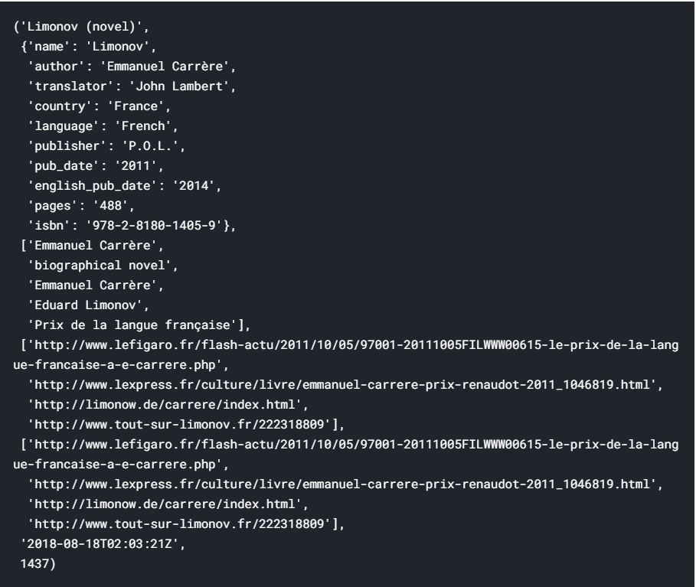
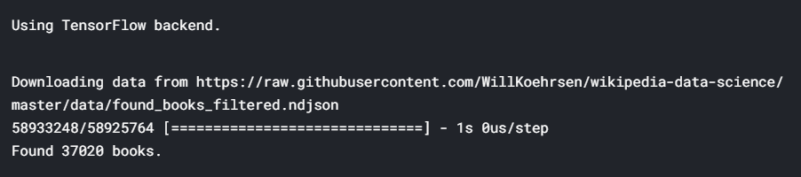
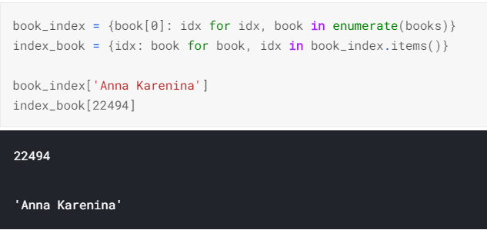
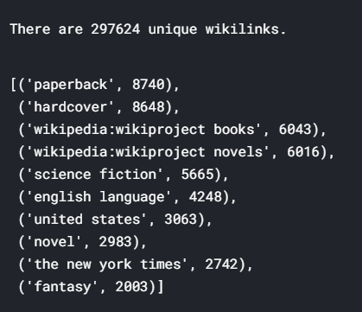
DATA cleaning
Count wikilink

Slide 4
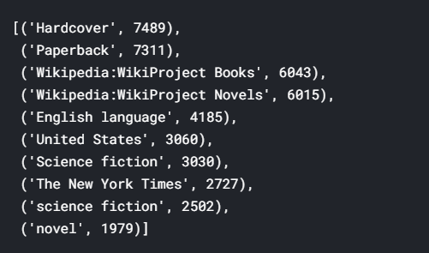
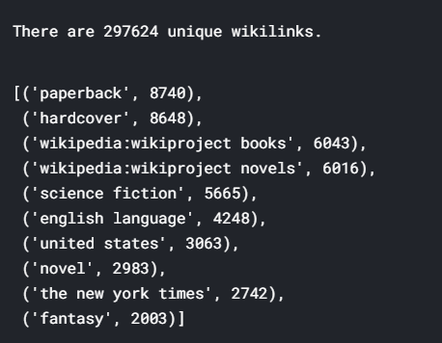
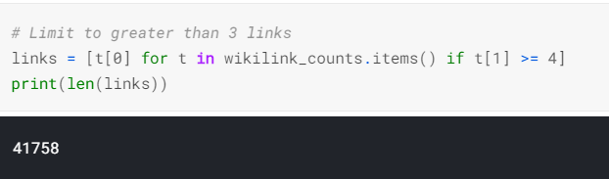
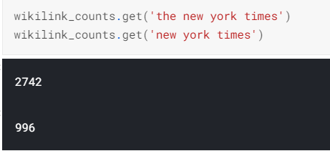
DATA cleaning Remove popular
- Remove Most Popular Wikilinks 4 items
- Similar to the idea of TF-IDF
lower
-Choose wikilinks mentioned 4 or more times.
- Helpful reduce noise

Slide 5
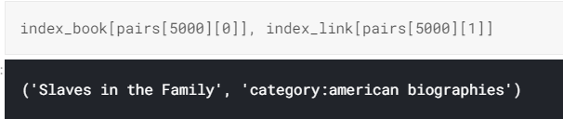
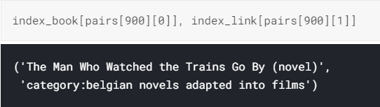
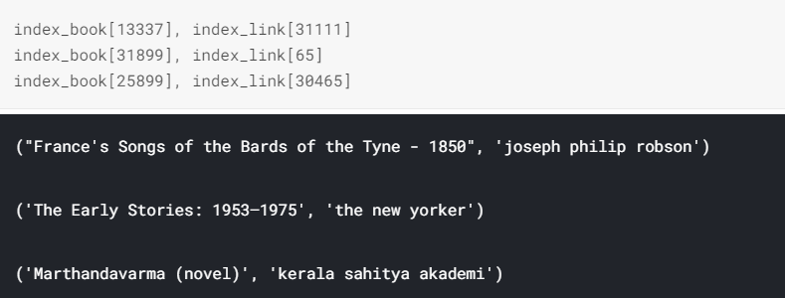
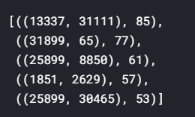
BUILD Train set

Slide 6

TRAIN / TEST DATA

Slide 7
Train/test set
Objective
Our primary objective is not to make the most accurate model, but to generate the best embeddings to train our network .
Instead of testing on new data, we'll look at the embeddings themselves to see if books that we think are similar have embeddings that are close to each other.
To separate validation / testing set, then we would be limiting the amount of data that our network can use to train.
To concerned about overfitting because we do not need our model to generalize to new data and our goal is the embeddings,

Slide 8
Generate Train Sample
To generate positive samples and negative samples to train the neural network.
The positive samples pick a pair from pairs and assign it a : 1.
The negative samples pick one random link and one random book, make sure they are not in pairs, and assign them a : -1 or a 0.

Slide 9
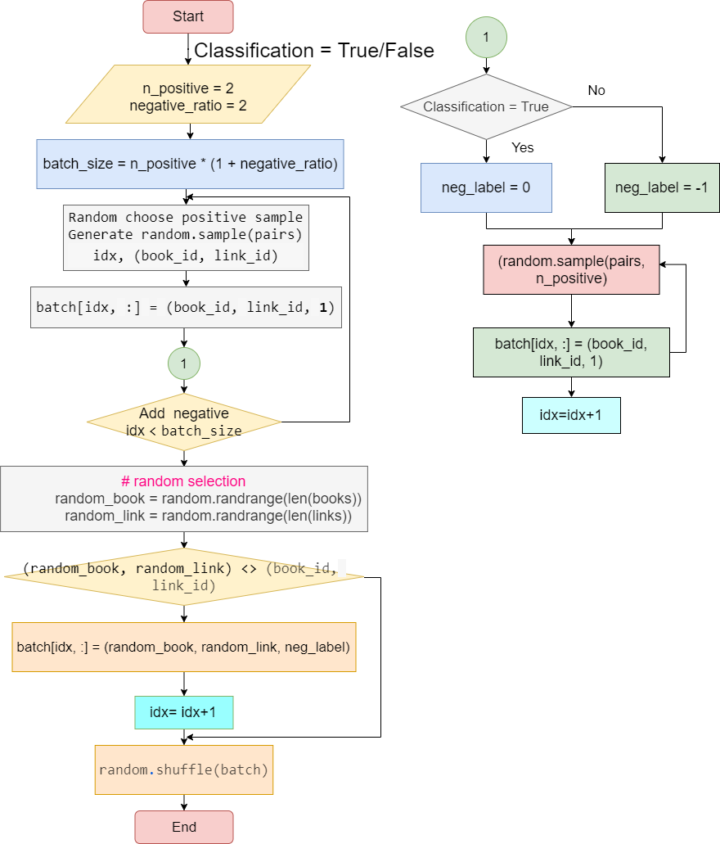
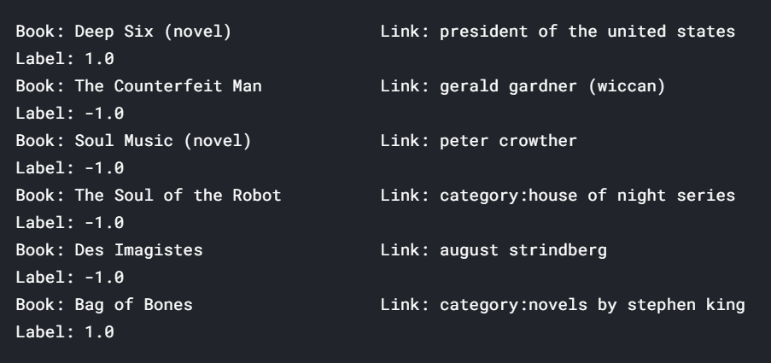
Create training Pairs and label
Remark :
- Over 770,000 positive examples.
- The negative example will random in sample and the results pair is not in pairs.

Slide 10
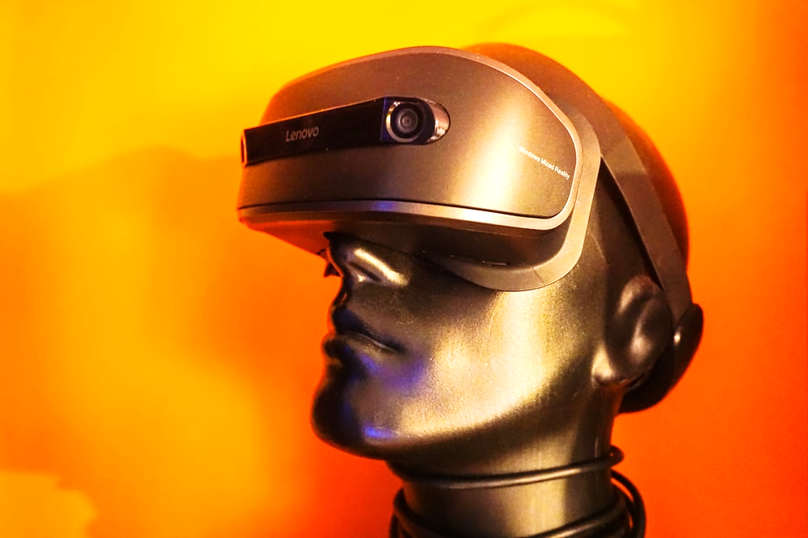
Neural Network Embedding
Model

Slide 11
Neural Network Embedding Model
Regression Model
Our labels are either -1 or 1, using regression model (make mean squared error minimize the distance between the prediction and the output)
Using the dot product with normalization means dot layer is finding the cosine similarity between the embedding for the book and the link.

Slide 12
Neural Network Embedding Model
For classification
Dense layer with a sigmoid activation to squash the outputs between 0 and 1,
The loss function for classification is binary_crossentropy
To measures the error of the neural network predictions in a binary classification problem
To measure of the similarity between two distributions.
To calculating the gradients through backpropagation - is Adam in both cases(Adam is a modification to Stochastic Gradient Descent) or updating the model parameters.

Slide 13
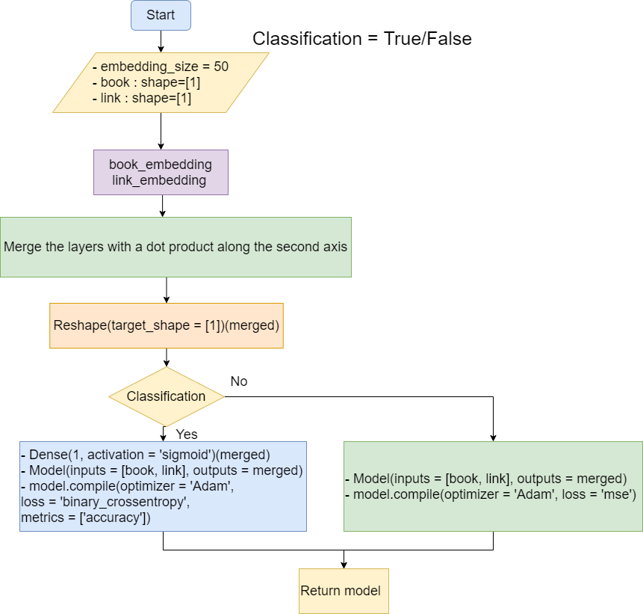
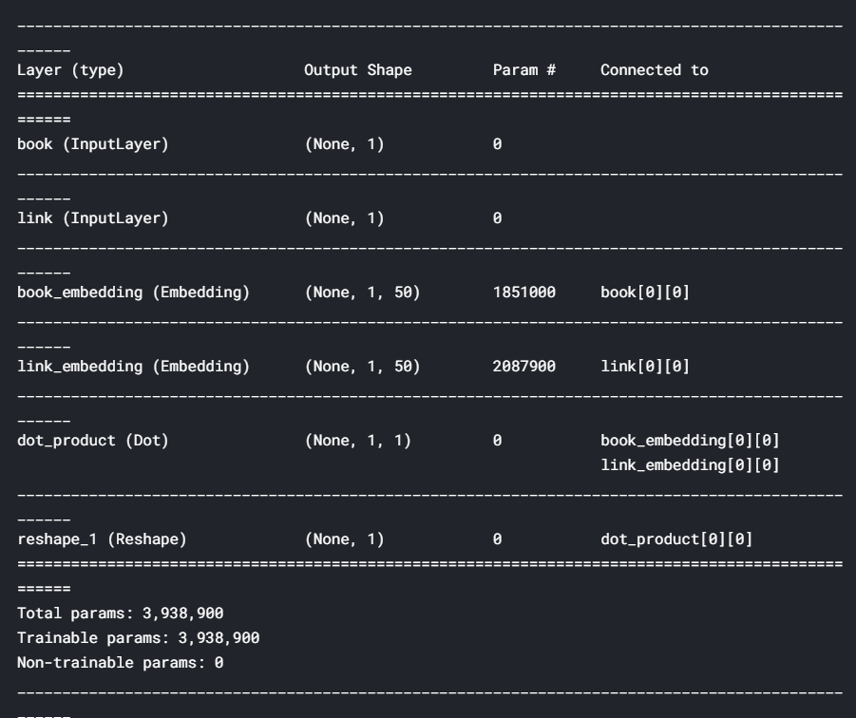
Book embedding model
Remark : There are nearly 4.0 million weights (parameters) that need to be learned by the neural network

Slide 14
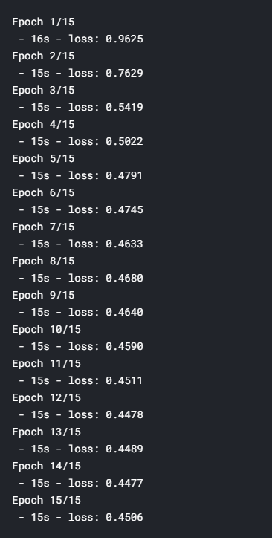
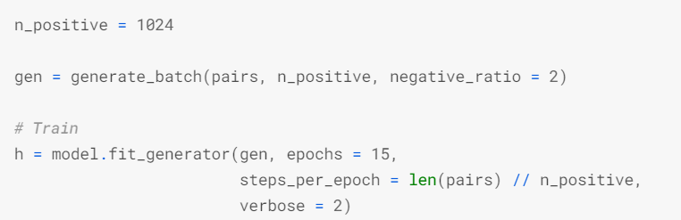
Train model
Save Model : first_attempt.h5

Slide 15
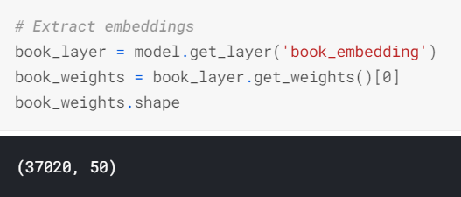
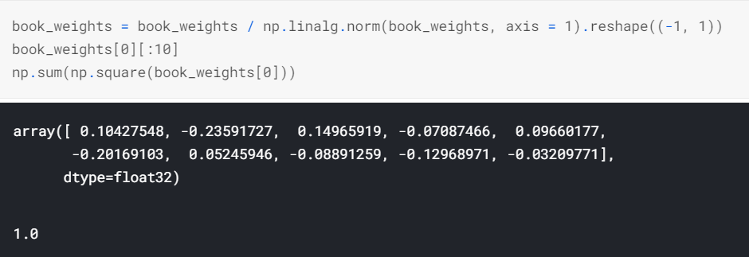
Extract Embedding analyze
Calculation: Book frequency 37020
50-dimensional vector.
To normalize the embeddings
so that the dot product between two embeddings becomes
the cosine similarity

Slide 16

Find Similarity

Slide 17
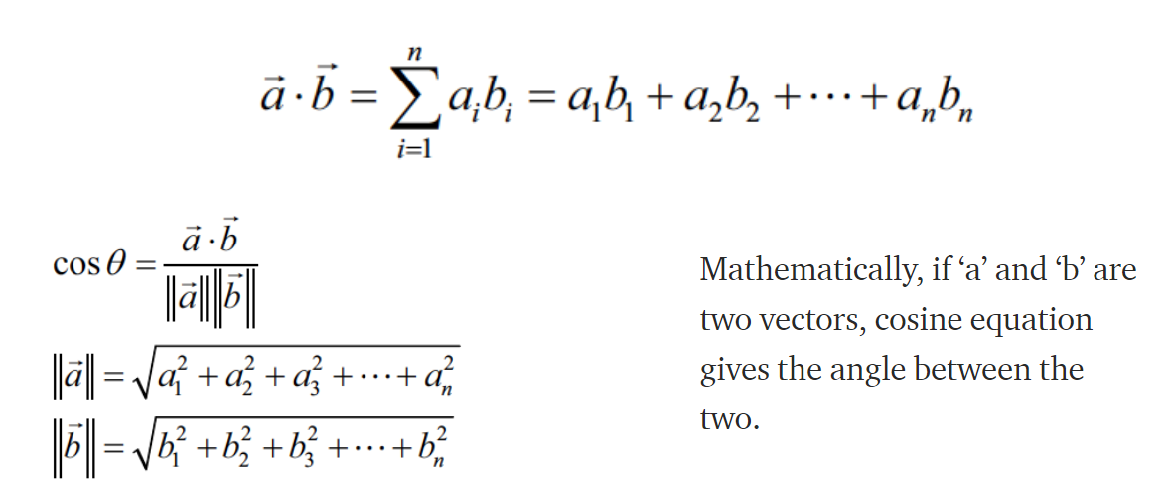
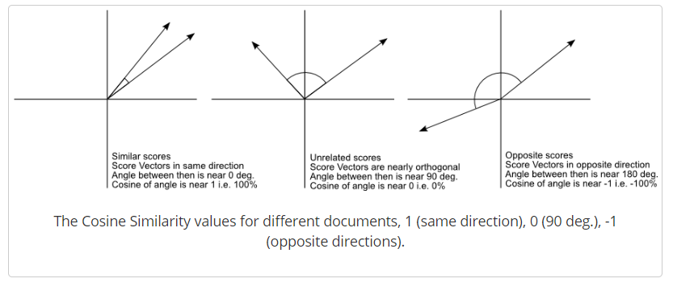
Cosine similarity
From : https://medium.com/acing-ai/what-is-cosine-similarity-matrix-f0819e674ad1

Slide 18

Book

Slide 19
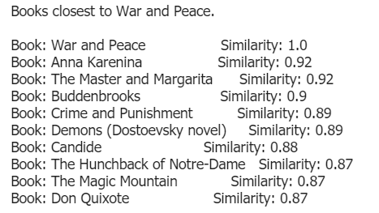
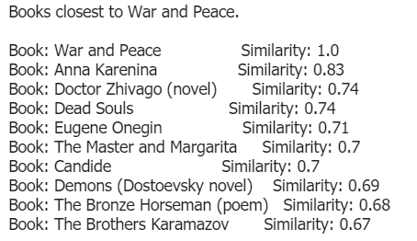
Books :war and peace
Classification = False (RG)
Classification =True (DL)
From : http://blog.christianperone.com/2013/09/machine-learning-cosine-similarity-for-vector-space-models-part-iii/

Slide 20
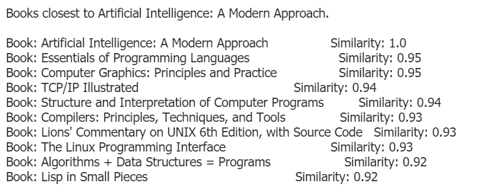
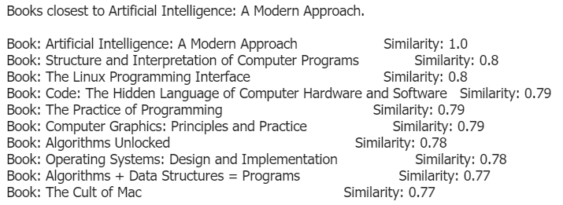
Books : Artificial intelligence(AI)
Classification = False (RG)
Classification =True (DL)

Slide 21
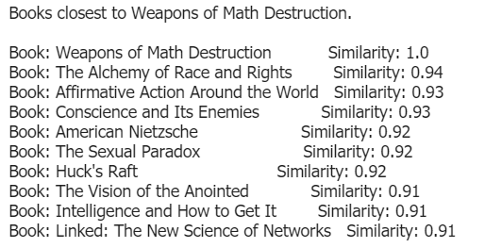
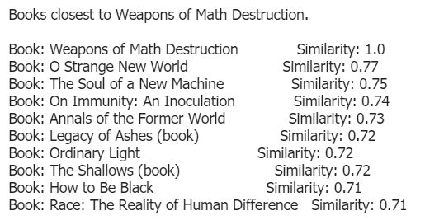
Books :Weapons of math Destruction
Classification = False (RG)
Classification =True (DL)

Slide 22
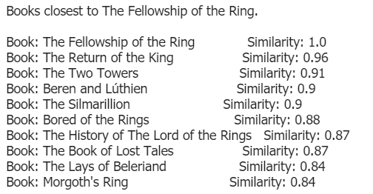
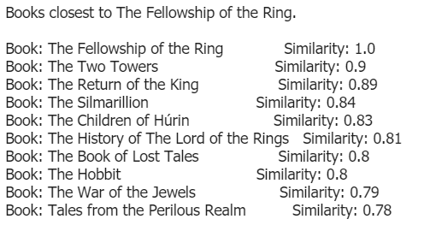
BOOKs :the fellowship of the ring
Classification = False (RG)
Classification =True (DL)

Slide 23

pages

Slide 24
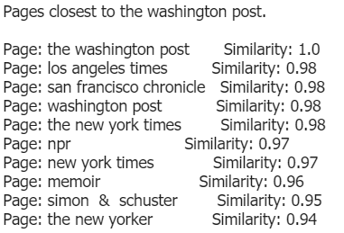
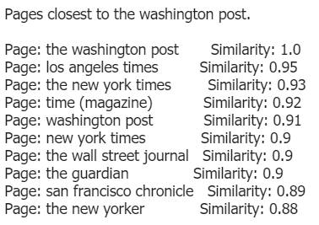
Pages : washington post
Classification = False (RG)
Classification =True (DL)

Slide 25
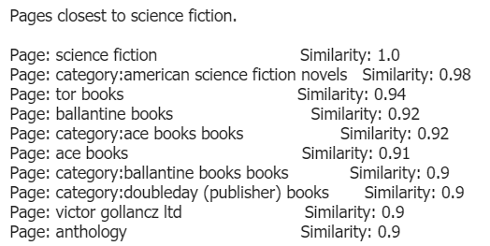
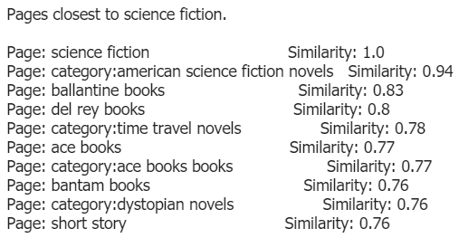
Pages Closet to science fiction
Classification = False (RG)
Classification =True (DL)

Slide 26
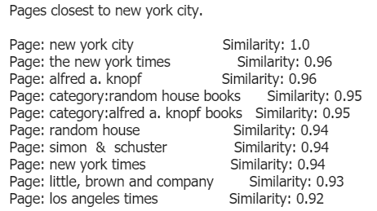
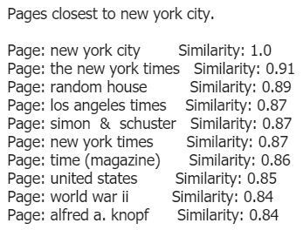
Pages : new York city
Classification = False (RG)
Classification =True (DL)

Slide 27

Data visualization

Slide 28
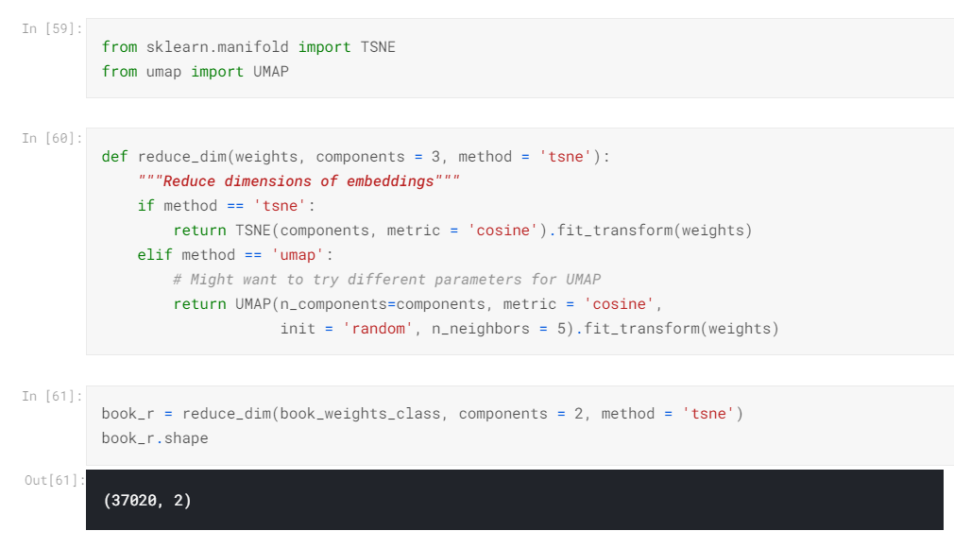
TSNE and UMAP

Slide 29
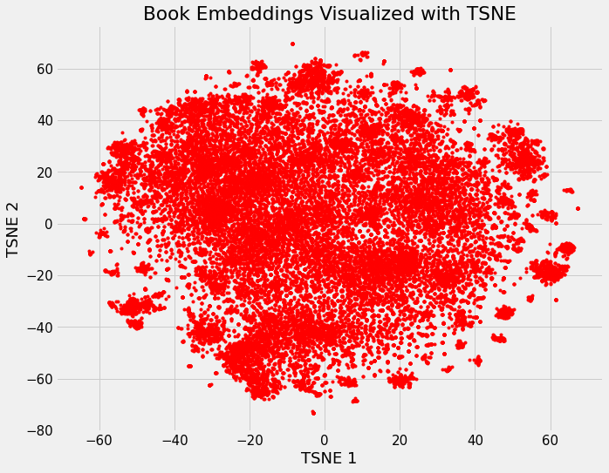
TSNE: t-Stochastic Distributed Neighbors Embedding
We've now taken the initial 37,000 dimension book vector and reduced it to just 2 dimensions.

Slide 30
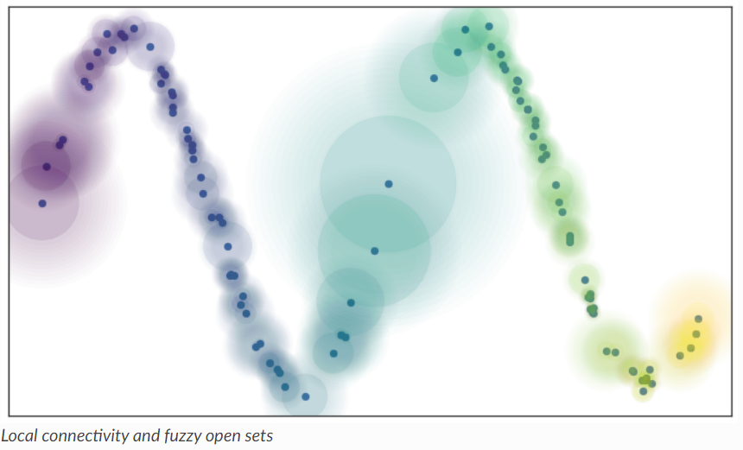
UMAP
Uniform Manifold Approximation and Projection
From : https://umap-learn.readthedocs.io/en/latest/how_umap_works.html

Slide 31
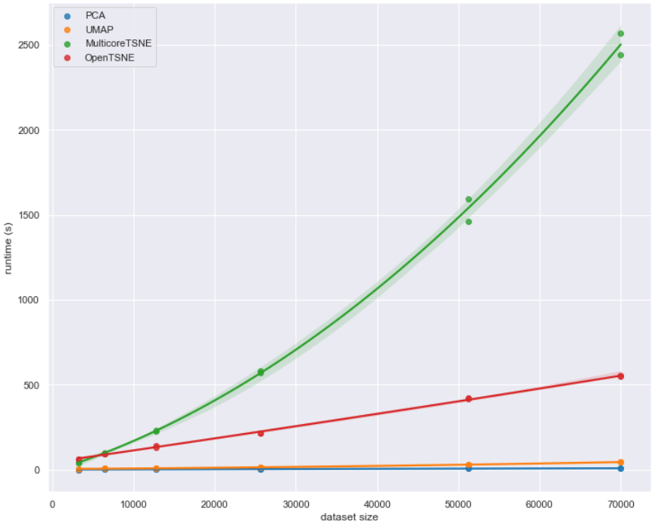
Performance RUNTIME
From : https://umap-learn.readthedocs.io/en/latest/performance.html

Slide 32
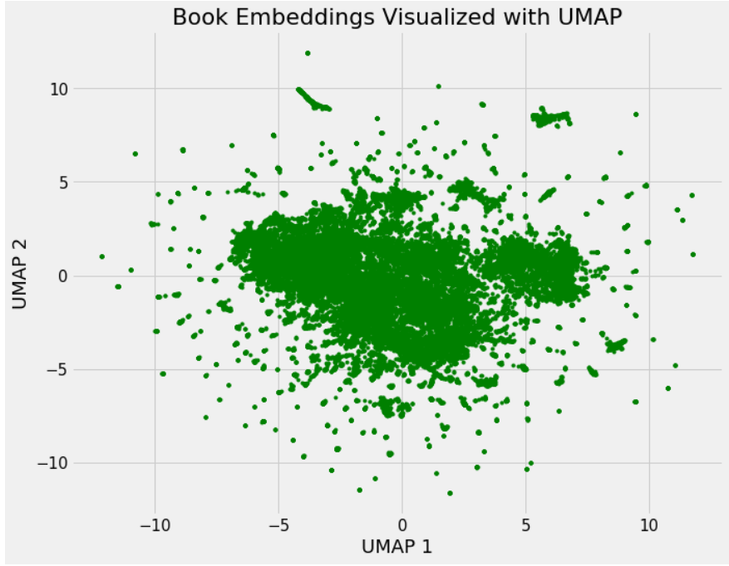
UMAP

Slide 33
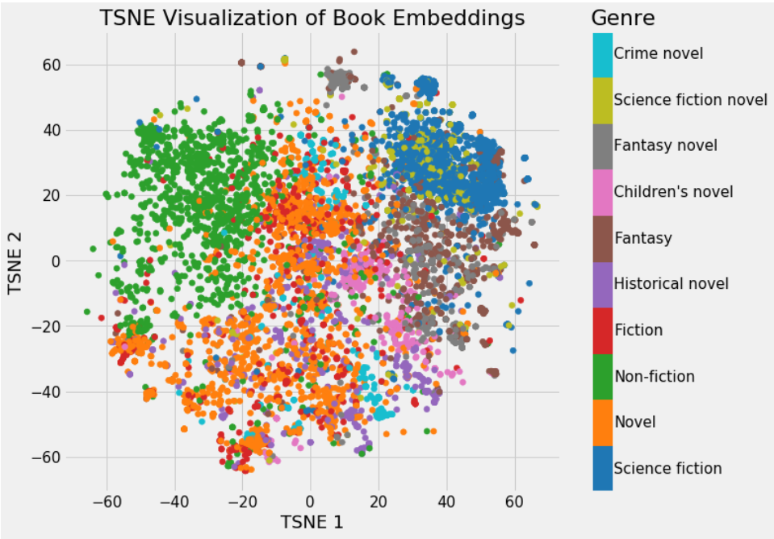
TSNE : BOOK Embedding

Slide 34
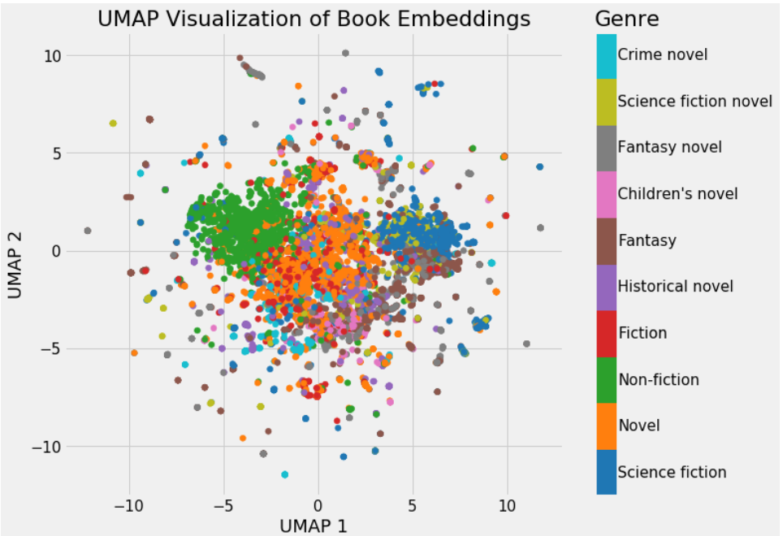
UMAP : BOOK Embedding

Slide 35
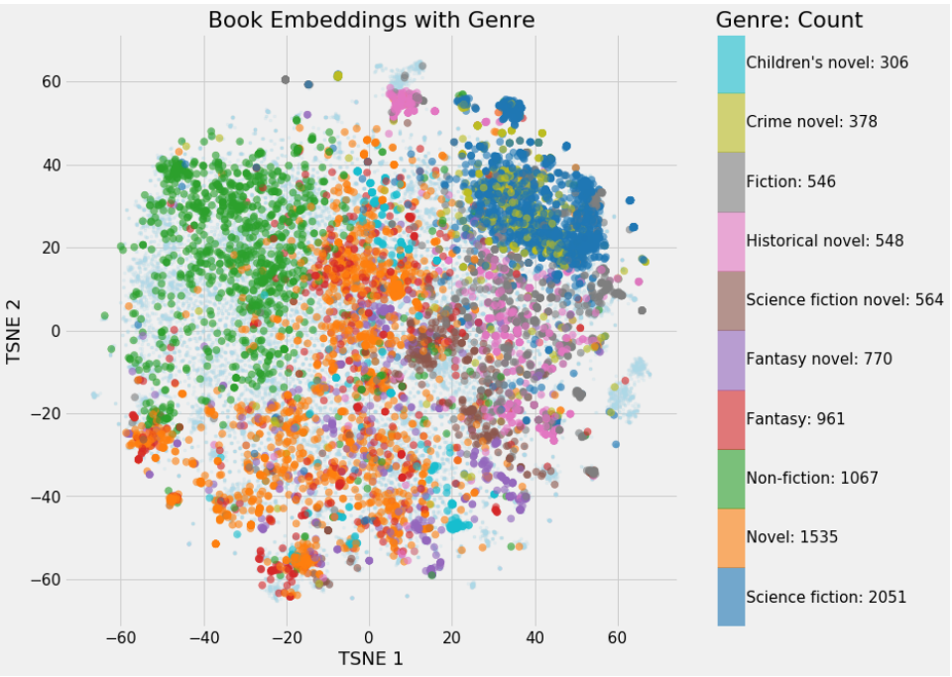
Tsne : BOOK : Genre adapt color

Slide 36
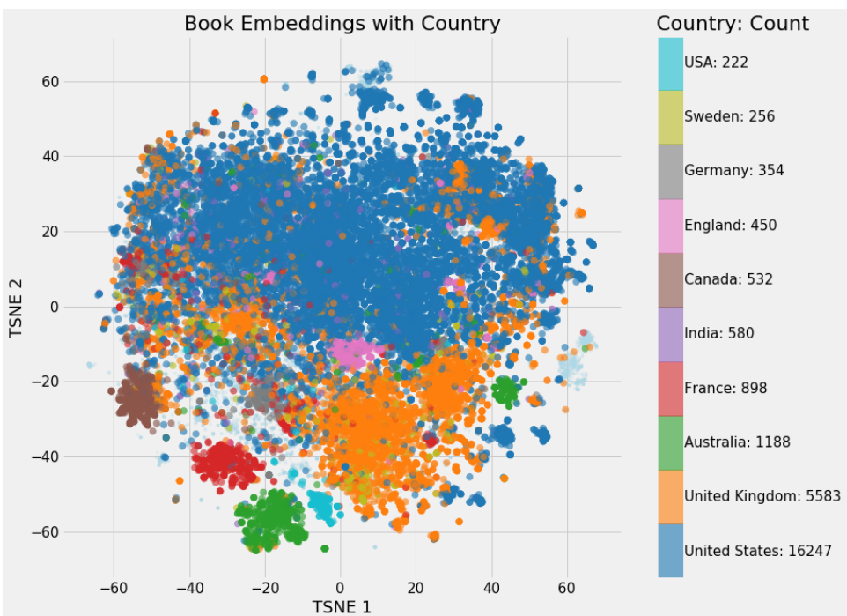
Tsne BOOK : country

Slide 37
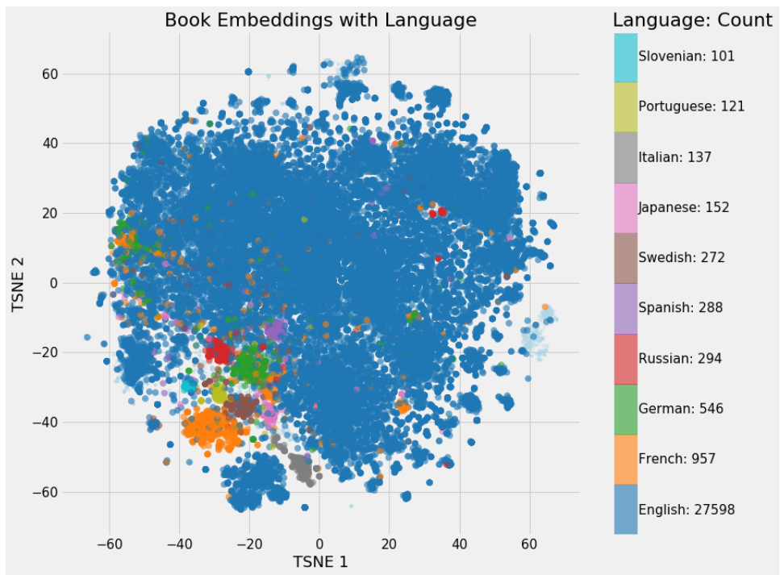
Tsne BOOK :Language

Slide 38
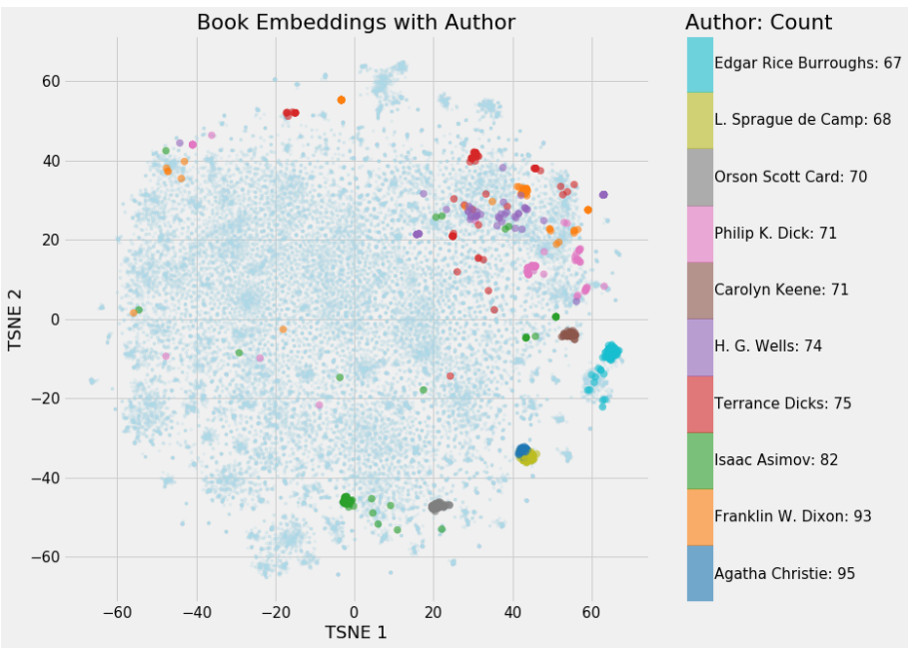
Tsne BOOK : Author

Slide 39
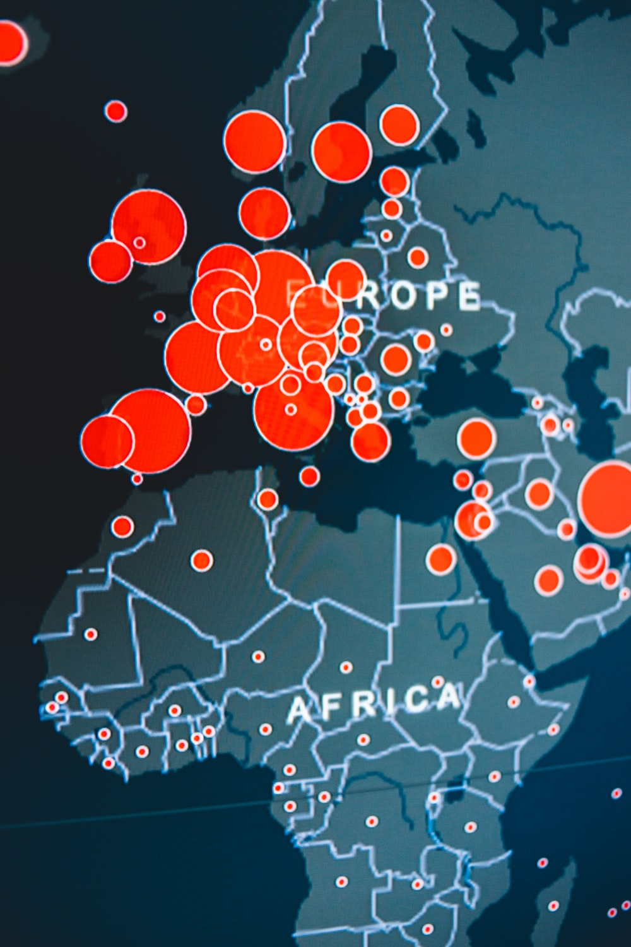
Plot Book Nearest Neighbors

Slide 40
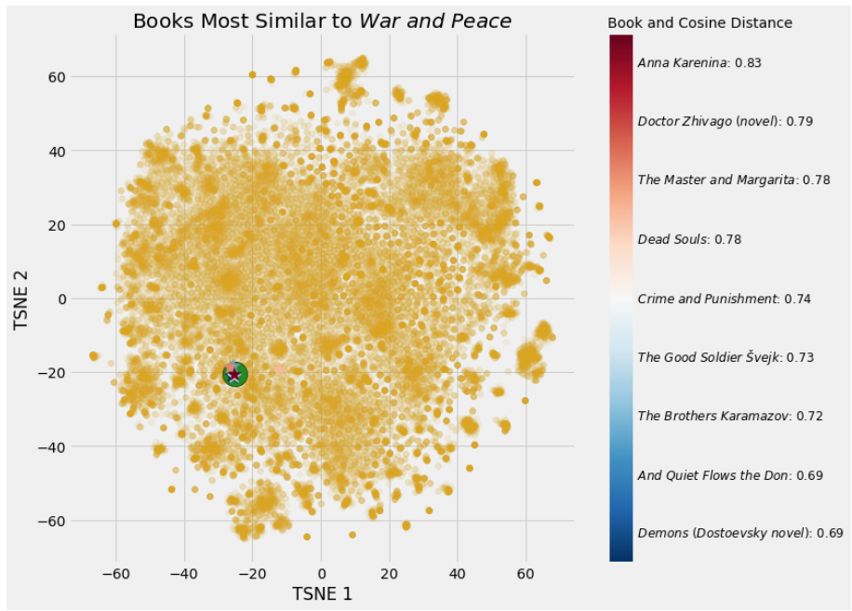
Tsne BOOK : war and peace 9 items
We can see that even though these are the closest books in the 50-dimensional embedding space, when we reduce it down to 2 dimensions, the same separations are not preserved.

Slide 41

Tsne Books : brief history of time 9 items
10 most popular categories

Slide 42

Plot Multiple Books and Pages

Slide 43

Tsne Pages : new York times 9 items

Slide 44

Tsne Pages : Jame Joyce 9 items

Slide 45

Tsne Pages :margeret at wood

Slide 46

Tsne Pages : leo tolstoy

Slide 47

Embeded Book with Closest neighbors

Slide 48

Embeded Pages with Closest neighbors

Slide 49


